Slide 1
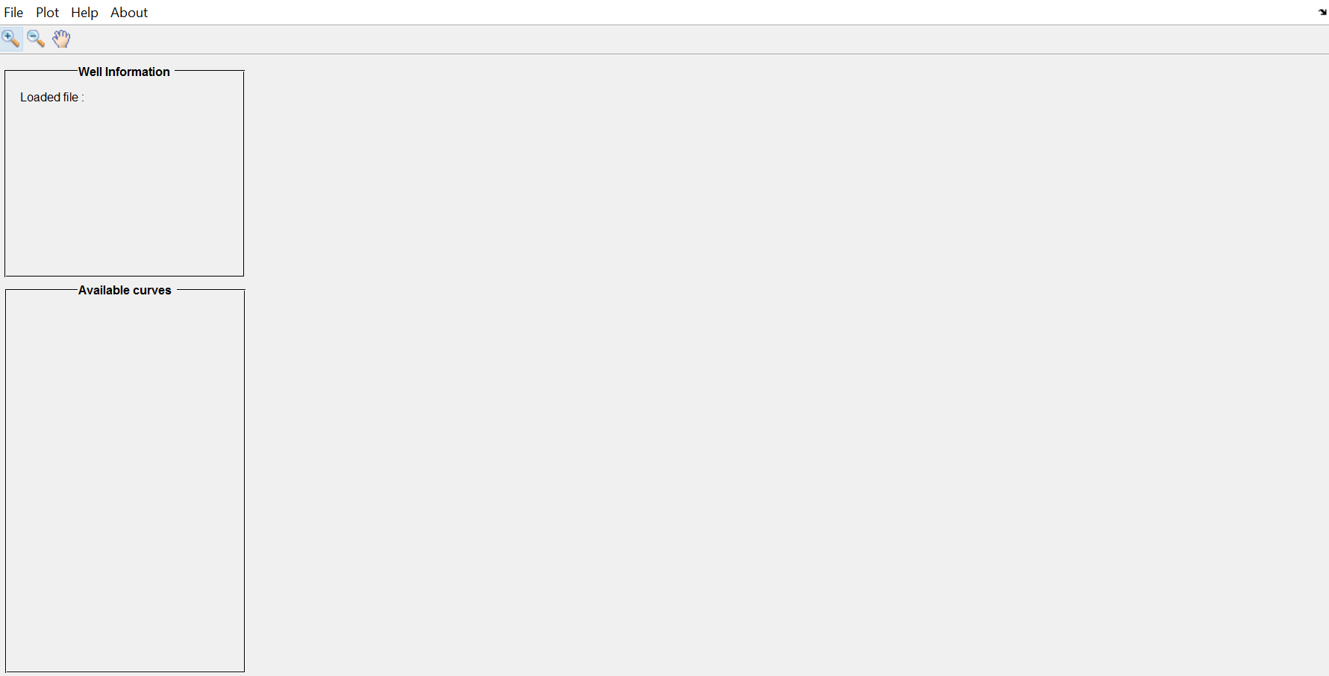
Menu bar
Toolbar
Well logging plot section
Well information panel
Available curves panel

Slide 2
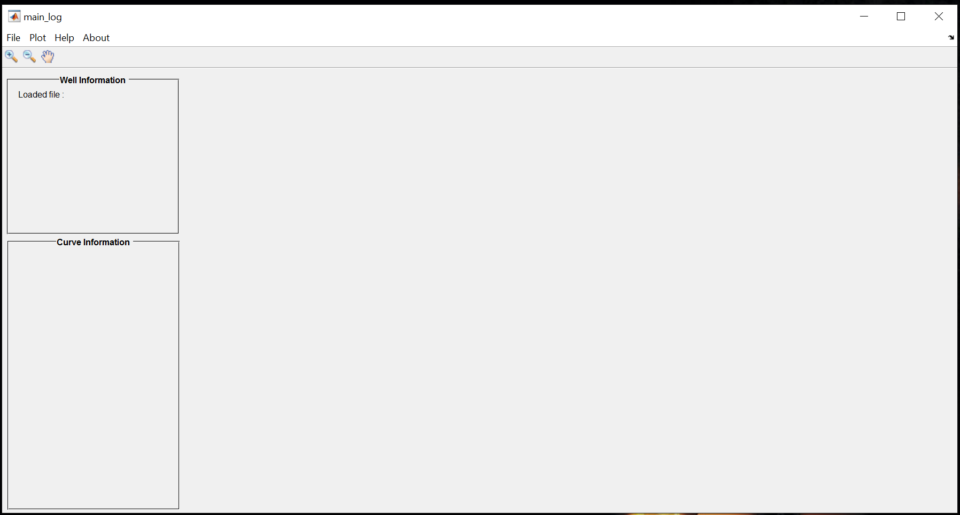
Figure/ window
Well information panel
Source code title
Menu bar
Toolbar
Curves information panel

Slide 3
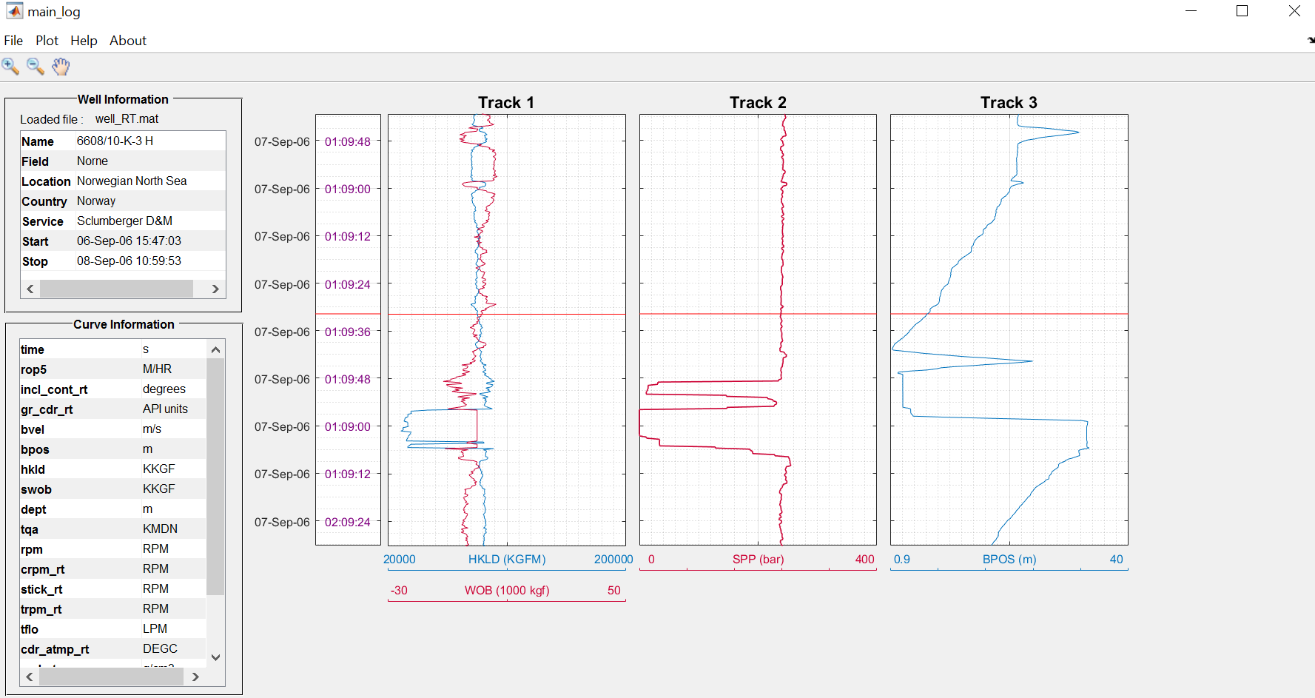
Date
Time
Log track
Track name
Track curves
Helping line
Curve legends

Slide 4
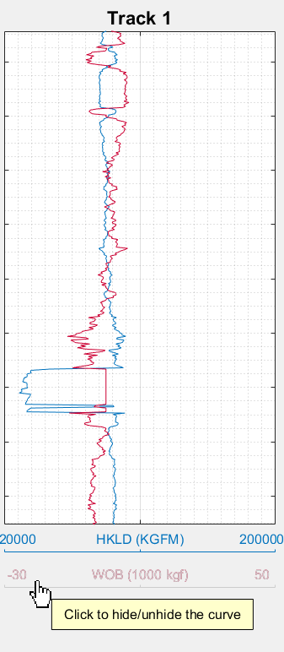
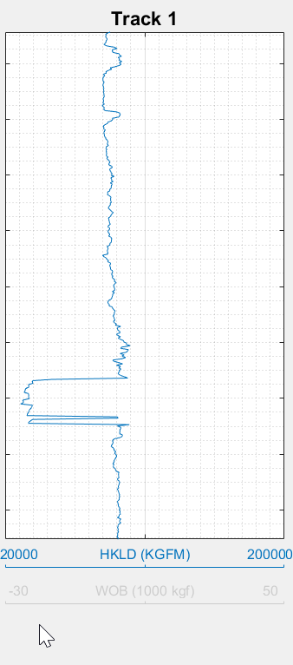


Slide 5
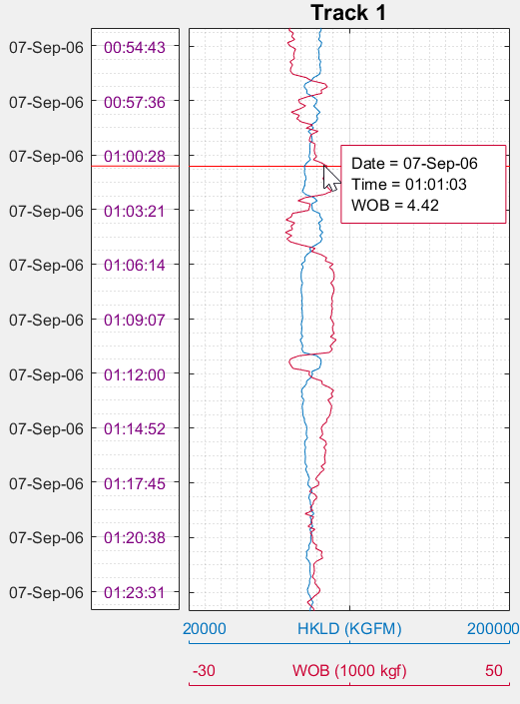

Slide 6
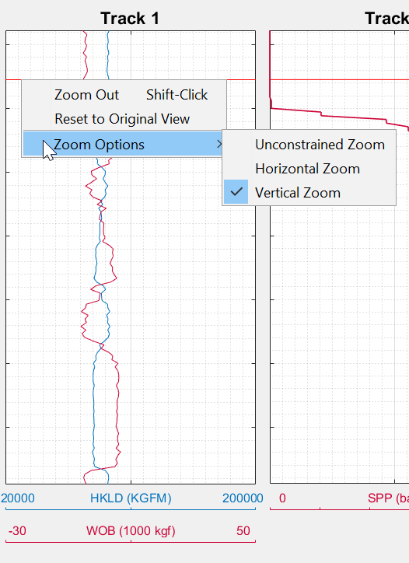

Slide 7
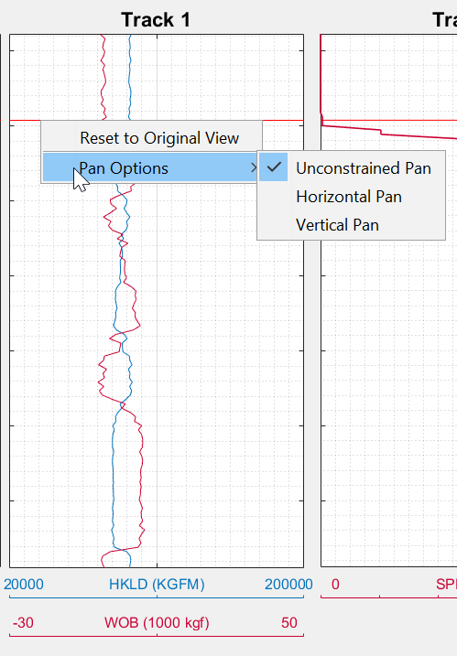

Slide 8
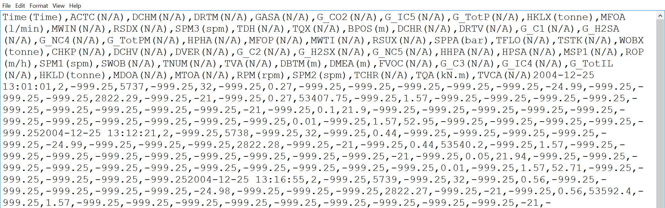
comma delimiter
comma delimiter
TIME, ACTC(N/A), BDIA(N/A),……
“TIME”,”ACTC”,”BDIA”,……
curve name
curve units
Curve information section
Log data section

Slide 9
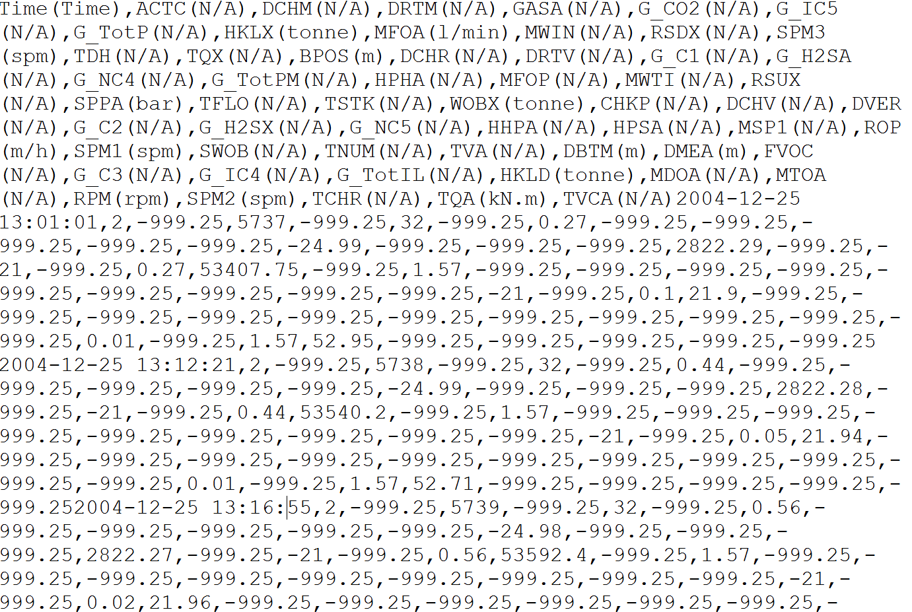
Curve information section
Log data section

Slide 10
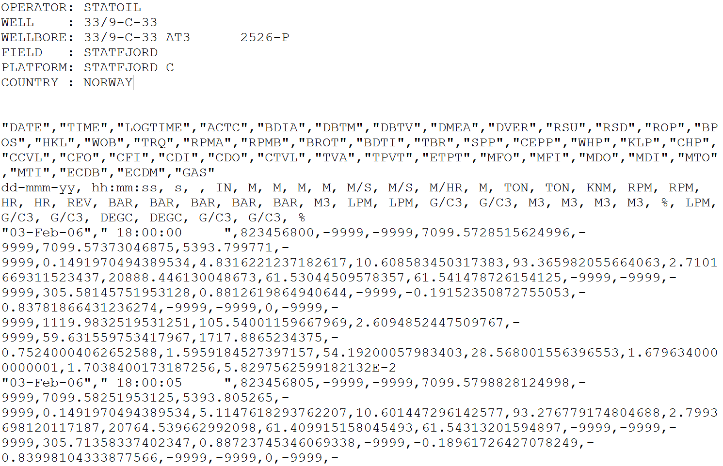
Well information
Curve mnemonic
Curve units
Log data

Slide 11
